Slide 1

Sentiment Analysis of Customer Feedback Using Large Language Models
Students Details
Objective / Scope (2) | Plan of Execution (2) | Implementation (2) | Presentation (2) | Insight on project area (2) | Total (10)

Slide 2
Module Details
Objective & Scope
Problem Statement
Plan of Execution
Module 1
Module 2
Module 3
Conclusion
Reference

Slide 3
Objective & Scope
This project involves developing a multilingual large language model designed to analyze customer feedback sentiment.
The model will be implemented as an API, enabling seamless integration with any e-commerce website. By leveraging advanced natural language processing techniques, the API will provide a comprehensive overview of product performance from the customer's perspective.
It will help businesses understand customer sentiments across different languages, offering valuable insights into product reception and overall performance.

Slide 4
Problem Statement
Current sentiment analysis tools for e-commerce are fragmented and inefficient, often addressing customer feedback in separate languages and struggling with large data volumes.
We propose a multilingual sentiment analysis API to offer a unified and efficient solution for understanding and analyzing customer feedback across various languages.
The Pipelines are not updated in real time and updating may cost as same as training.

Slide 5
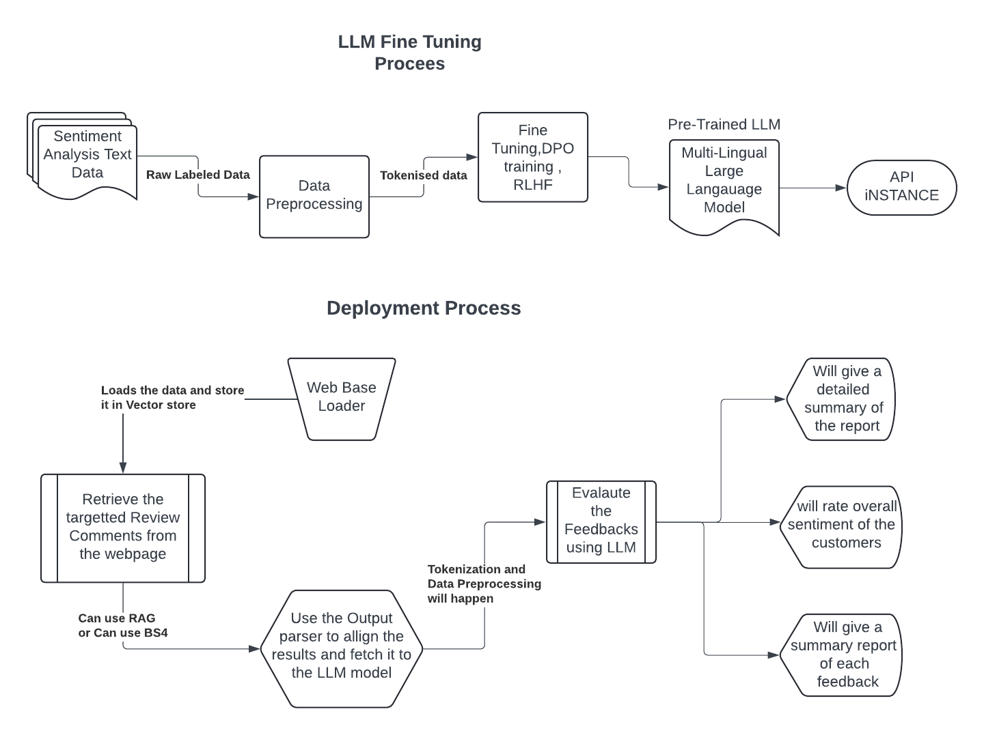
Plan of Execution

Slide 6
Module 1

Slide 7
Module 2

Slide 8
Module 3

Slide 9
Conclusion

Slide 10
Reference

